Slide 1
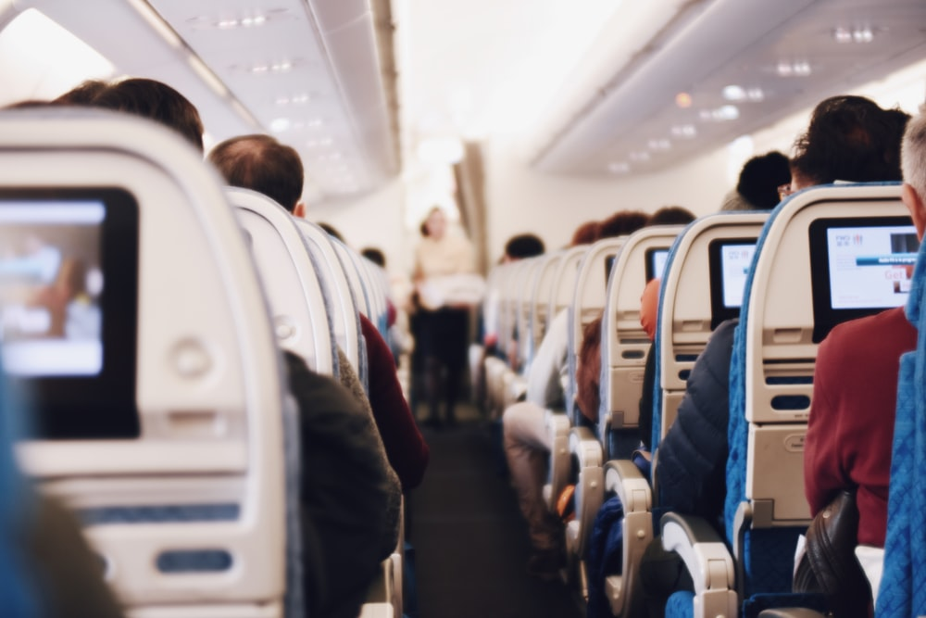
Airline Passanger Satiffaction
Febrio Akbar

Slide 2
Table of Contents
01
02
03
05
About Dataset
Business Problem
Defines the features of the dataset used
Make questions from existing problems
Data Preparation
04
Business Insight
Prepare data so that it is more ready to be processed
Look for the relationship between features and how they affect the target
ML Modeling
06
Improvement Simulation
Create and select the most optimal ML model
Running a simulation of the improvement

Slide 3
About Dataset
1
The dataset used describes the characteristics of each passenger and how satisfied they are with each service provided by the airline, so that a final conclusion can be reached whether they are satisfied or neutral or dissatisfied.
Categorical Data
Numerical Data
Gender
Customer Type
Type of Travel
Class
Age
Flight distance
Departure Delay in Minutes
Arrival Delay in Minutes
Services Rating Data
Inflight wifi service
Departure/Arrival time convenient
Ease of Online booking
Gate location
Food and drink
Online boarding
Seat comfort
Inflight entertainment
flight service
On-board service
Leg room service
Baggage handling
Check-in service
flight service

Slide 4
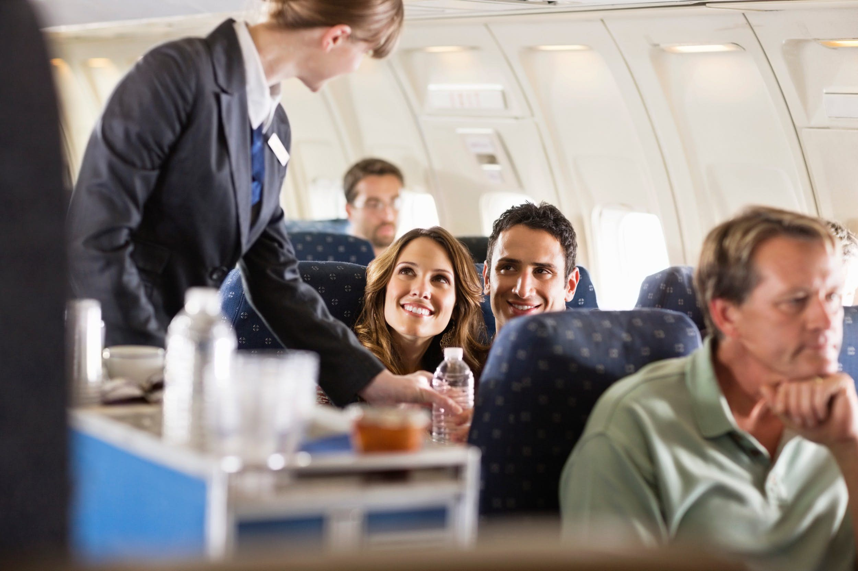


The Target:
Customer Satisfaction
Satisfied
neutral or dissatisfaction

Slide 5
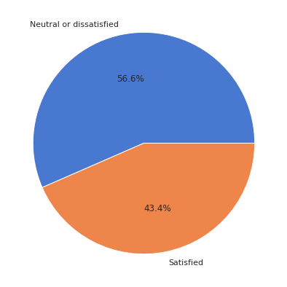
Business Problem
2
From the pie chart, we can see the customer that feels Neutral or Dissatisfied is a lot more than the satisfied ones. So, this is becoming a problem for the airline company.
Business Question:
What features that gave the biggest impact on customers satisfaction?
How do features relate to each other, especially the satisfaction?
How to improve customers satisfaction?

Slide 6
Data Preparation
3
>
>
>
Missing Value Handling
Drop First and Second row because it's useless
Convert columns into 'Categorical' type
Find Missing Values
319 of 129880
(0,03%)

Slide 7

Business Insight
4

Slide 8
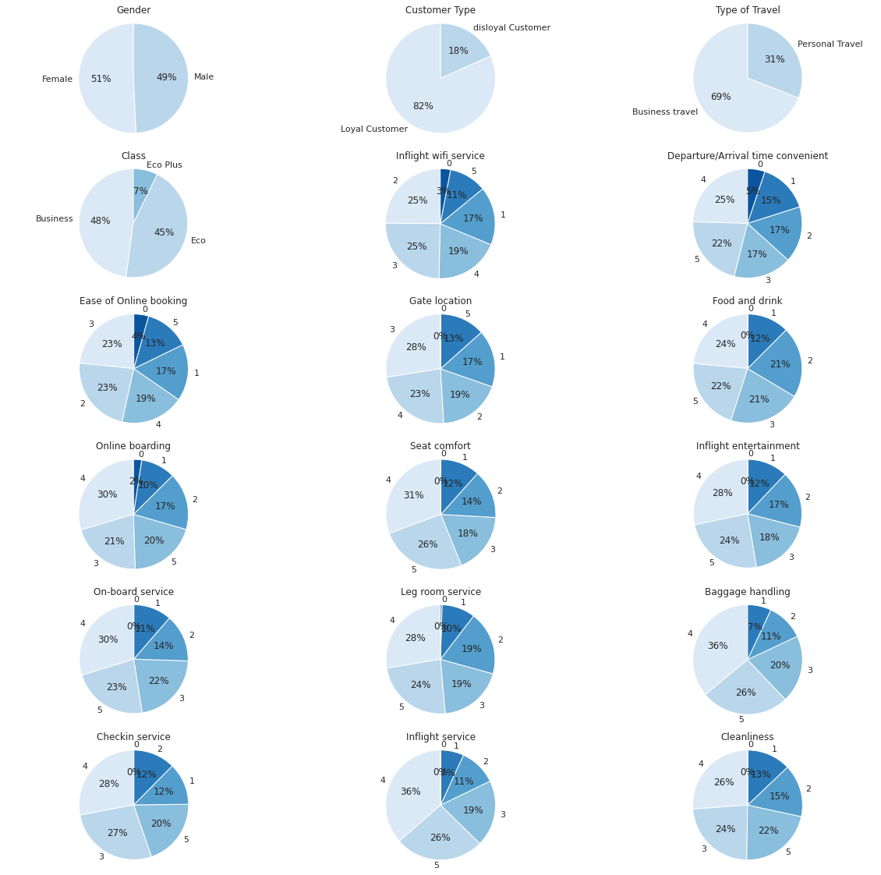
Pie Chart of categorical
data distribution

Slide 9
The number of men and women in this sample is approximately the same

Slide 10
The vast majority of the airline's customers are repeat customers

Slide 11
Most of our clients flew for business rather than personal reasons

Slide 12
About half of the passengers were in business class

Slide 13
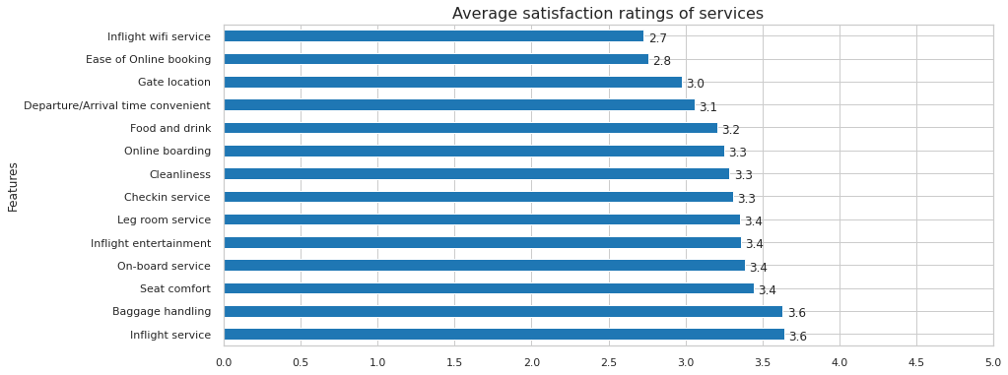
Average satisfaction ratings of services

Slide 14
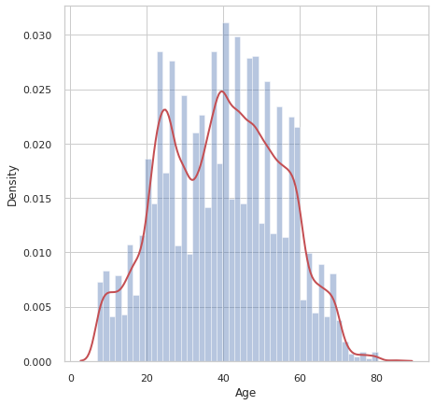
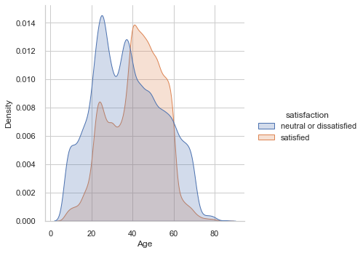
Age Distribution
Majority of airline service users are between 25 and 60 years old, Satisfied customers are mostly aged 40 years and over.

Slide 15
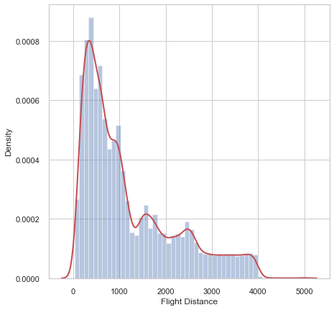
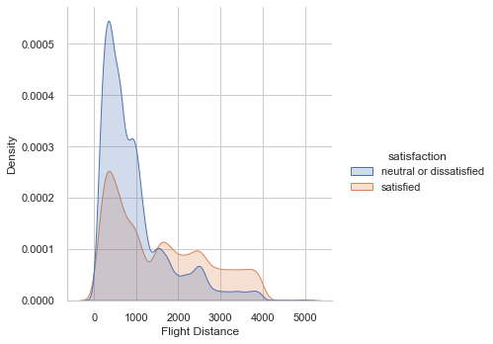
Flight Distances Distribution
Airlines tend to serve flights under 1500 km. Interestingly, the majority of passengers who fly above 1500 km are satisfied compared to those who take short flights.

Slide 16
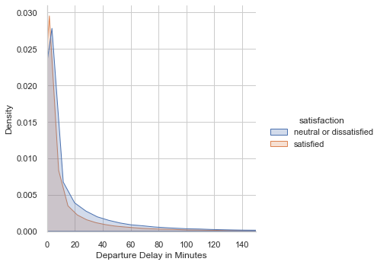
Departure Delay Time Distribution
distribution of the length of time delay in departure does not show a significant difference.

Slide 17
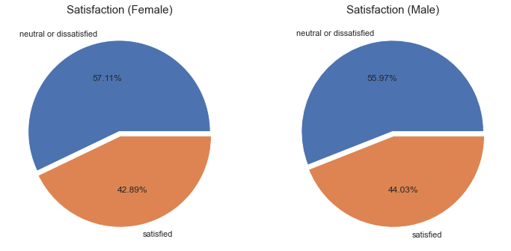
Gender to Satasisfaction
The distribution of dissatisfied and satisfied passengers in the male and female categories does not show a significant difference.

Slide 18
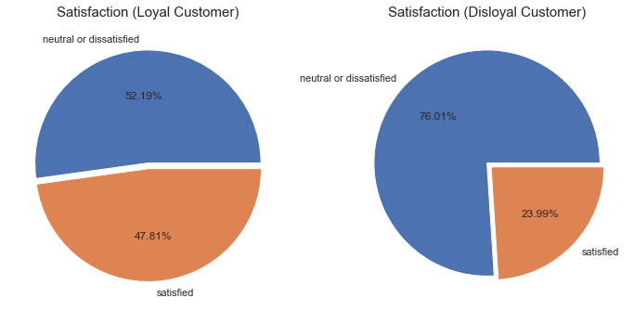
Customer Type to Satasisfaction
More than 3/4 of 'Disloyal' customers are dissatisfied with what they get, this is certainly natural. Uniquely, the majority of customers who have entered the 'Loyal' category are still not satisfied with the airline.

Slide 19
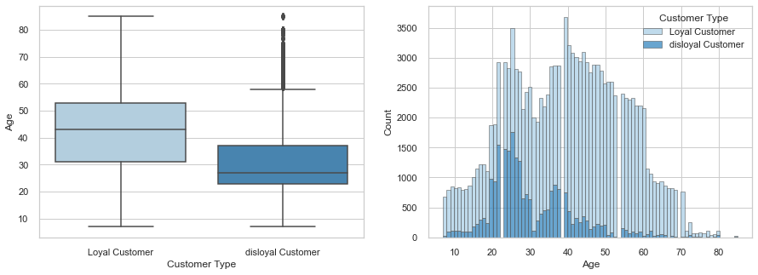
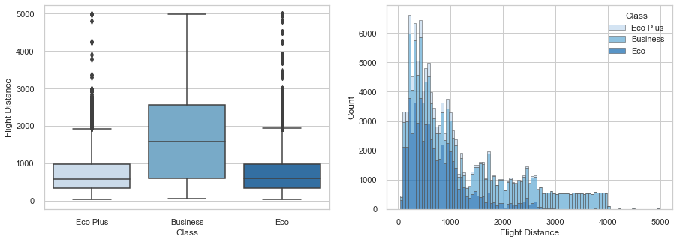
Age to Customer Type
Class to Flight Distance

Slide 20
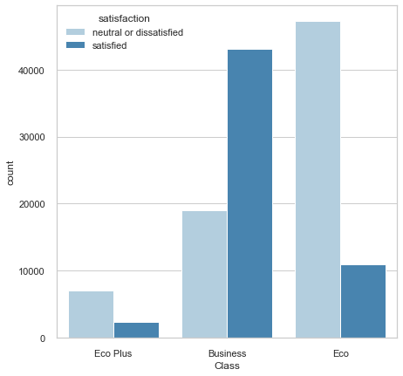
Class to Satisfaction
Service in business class has been sufficient to guarantee customer satisfaction. But it is inversely proportional to what customers feel in the Eco and Eco Plus classes feels.

Slide 21
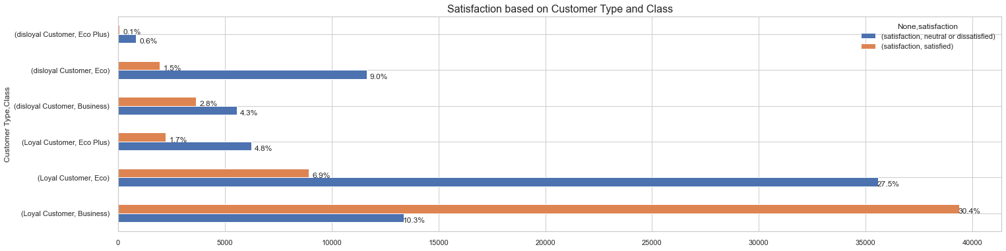
Satisfaction based on Customer Type and Class
only customers who fall into the "Loyal" category and are in the business class are the majority satisfied. Even "Disloyal" customers who are in business class are mostly dissatisfied. The difference also looks significant in other flight classes.

Slide 22
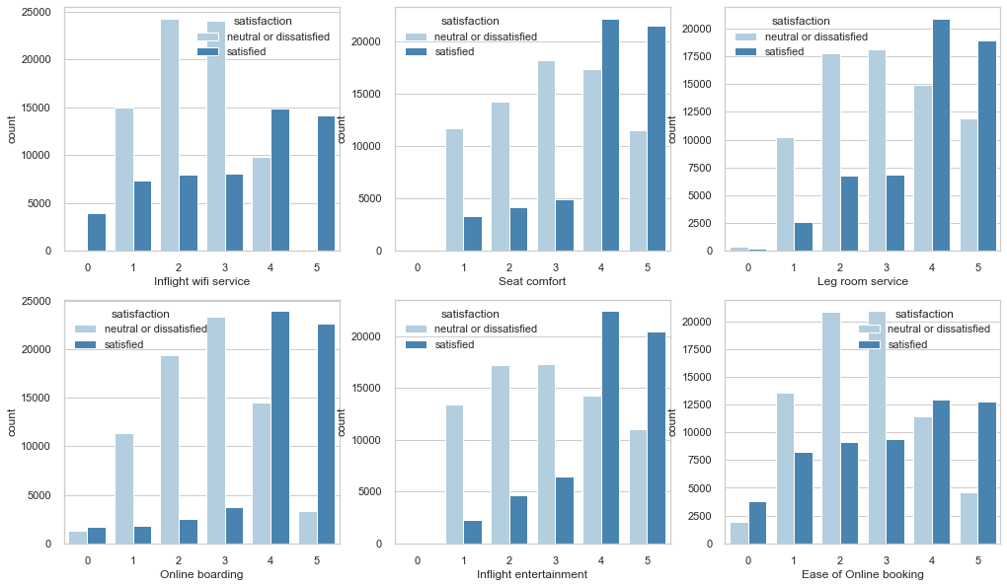
Service Rating Analysis

Slide 23
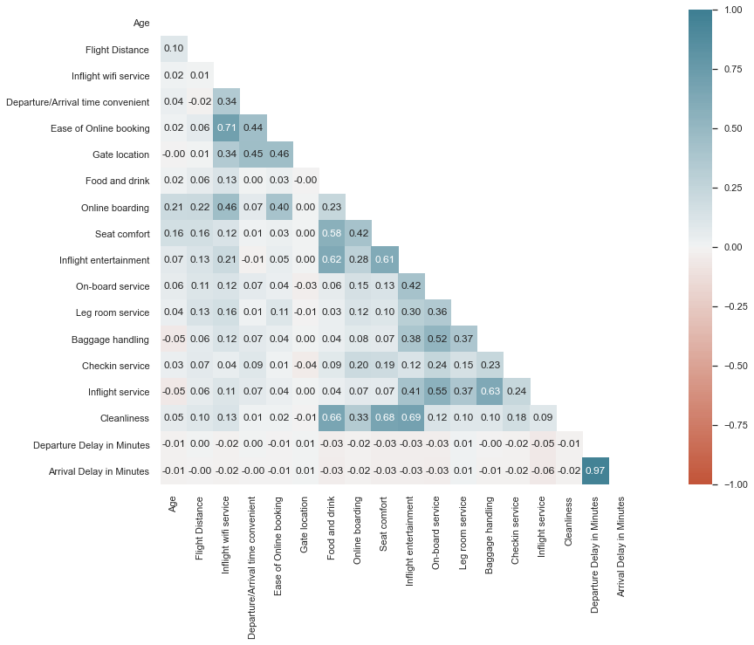
Features Correlations

Slide 24
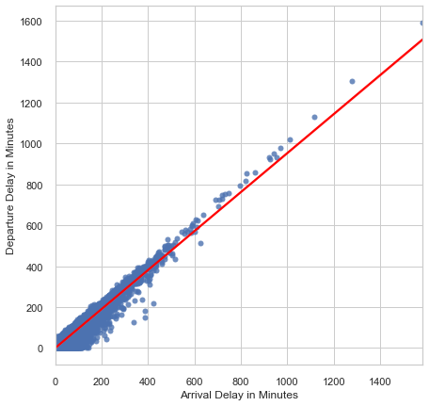
Arrival Delay in Minutes to Departure Delay in Minutes Correlation

Slide 25

Machine Learning Modeling
5

Slide 26
Pre-Processing
Categorical Data Encoding
Splitting Data
Scaling numerical data
Data Balance Check

Slide 27
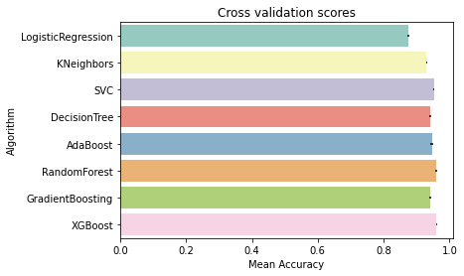
Cross Validation Score
Cross-validation is any of various similar model validation techniques for assessing how the results of a statistical analysis will generalize to an independent data set.

Slide 28
Models Summary
 | Accuracy | Recall | False Negative
XGBoost | 96% | 0 : 98% 1 : 94% | 2.52%
Random Forest | 96% | 0 : 98% 1 : 94% | 2.64%
Linear SVC | 87% | 0 : 90% 1 : 84% | 7.13%
Gradient Boosting Classifier | 96% | 0 : 97% 1 : 94% | 2.43%

Slide 29
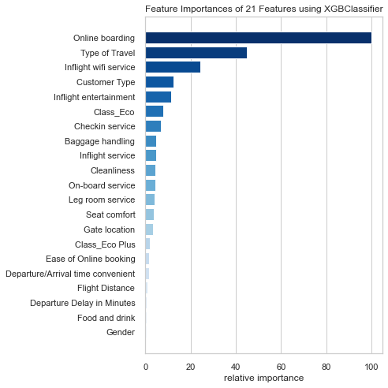
Feature Importance

Slide 30

Improvement Simulation
6

Slide 31


Improvement
Increase online boarding rating : 1 → 3
2 → 4
3 → 5
Increase Inflight wifi service rating : 1 → 3
2 → 4
3 → 5
Convert a small portion (about 3%) from "Personal Travel" to "Business Travel"

Slide 32
Result
Before improvement, the percentage of the satisfied customers is 43.45%
But after we consider the top 3 feature that affects customers satisfaction, which is:
Online Boarding Satisfaction Rating
Inflight wifi service Satisfaction Rating
Type of Travel
The percentage of the satisfied customers became 64.51%
So it can be said that customer satisfaction has increased by 21.06%

Slide 33
Actionable Recommendation to Make Improvement Come True
Increase Online Boarding Satisfaction Rating
Creating an online boarding platform that can be accessed via smartphones
Giving "something" to customers boarding via online
Ensure that the online boarding platform is easy to use and has no bugs
Increase Inflight wifi service Satisfaction Rating
Provides inflight wifi service on all airline fleets
Ensure stable and fast Wifi network speed
Ensure the Wifi network covers the entire plane
Increase Business Travel Frequency
Giving discounts/souvenirs to customers who are on business travel
Collaborating with various companies as their air transportation providers
Providing services and infrastructure that support customers who are on a business travel

Slide 34
Thank you

